Slide 1

Our Quality Control Technology

Slide 2
We back up our quality promises with transparency and accountability.
Regular inspections
Quantifiable standards for cleaning
Photos, timestamps, and GPS on inspections
Logins for your team
Regular reports on our performance
Notes:
We continually inspect your facilities and measure our own cleaning performance in quantifiable ways. Photos, timestamps, and GPS ensure each inspection accurately reflects how well everything was cleaned.
You can always check our performance via the OrangeQC web portal. As soon as you log in, you’ll see a dashboard with all our quality control data at a glance: our average inspection scores over time, how many inspections we’ve performed, our average response time for any issues, and more.
OrangeQC also compiles regular reports that give you greater insight into our performance. We’ve found this is a great way to communicate with our clients about our quality, what we’re doing to improve, and our process.

Slide 3
We use OrangeQC quality control technology to:
Track our performance
Report those findings to you
The result? Incredible data-backed insight and trust-building transparency.

Slide 4
Stress-free janitorial services.
We regularly review the analytics of our performance at your site.
We maintain a high level of service—and fix any problems quickly.
That’s how we get the details right while delivering excellent overall service.
Notes:
We regularly review the analytics of our performance at your site. This helps us ensure you’re receiving the same high level of service you signed up for—and lets us nip problems in the bud.
The technology we use helps us track our performance at every level, from the entire site to individual line items in each room. That’s how we get the details right while delivering an excellent overall clean.

Slide 5
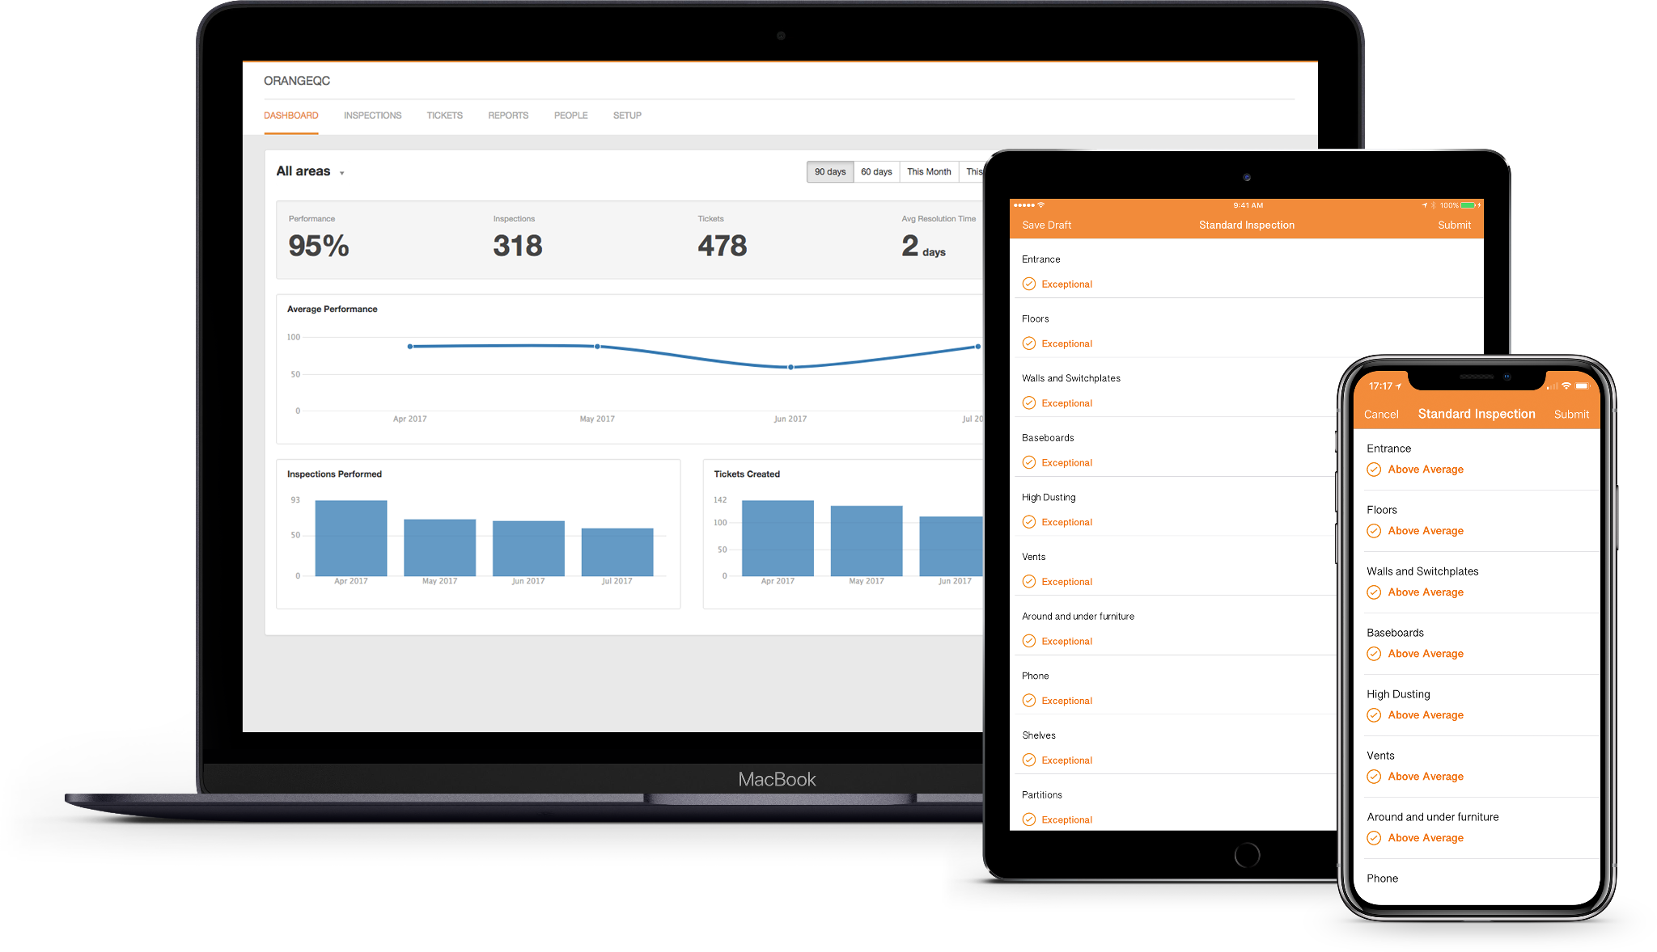
Notes:
On the left: How an inspection looks in the app, allowing us to inspect all the metrics important to you and document everything with photos and more.
On the right: A view of the dashboard when you log into the web app. This gives you a high-level overview of inspection scores in your facilities.

Slide 6
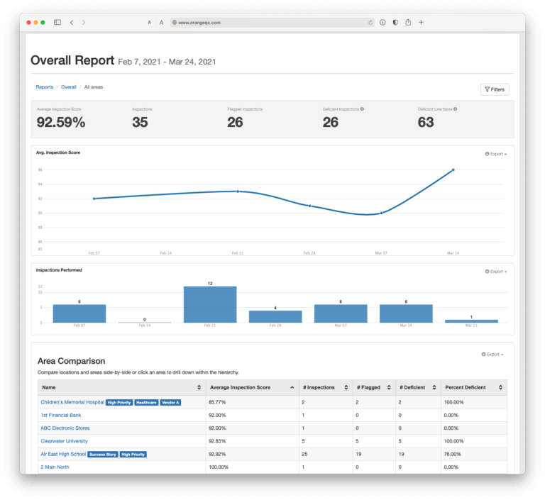
Notes:
We generate reports tracking the cleaning quality across areas and facilities.

Slide 7
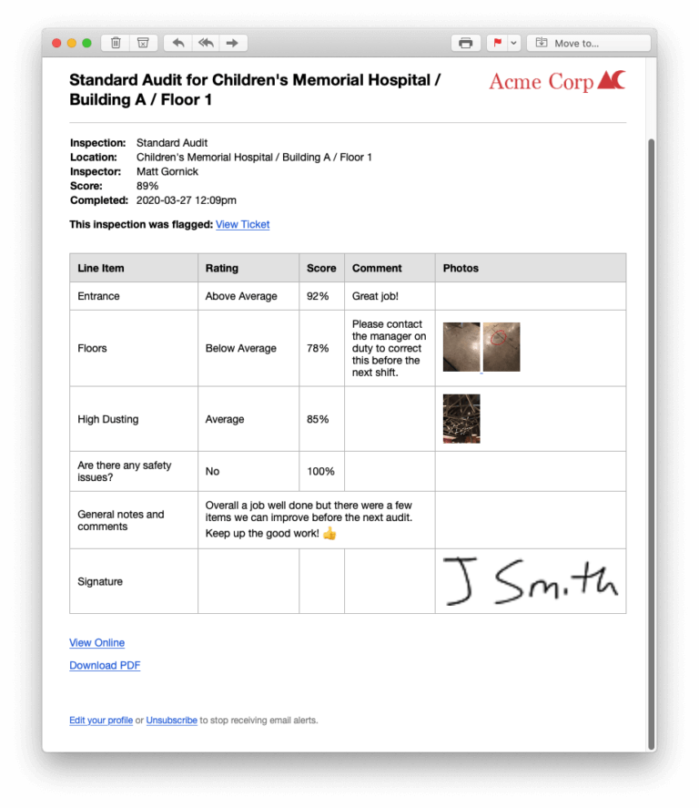
Notes:
An example of a specific inspection report.

Slide 8
Getting in touch with us is always easy.
We use OrangeQC as a communication hub.
It’s fast, easy, and gets your requests to the right person.
How? Send an email, log into a website, or (optionally) use a simple app.
No complicated systems to learn or programs to download.
Notes:
We also use OrangeQC as a communication hub. It’s fast and easy, and you’ll always know your requests are going to the right place.
The best part: you’ll never have to install complicated software programs. All you have to do is send an email, log into a website, or (optionally) download a simple app.

Slide 9
Here’s how it works:
You send an email to our dedicated address (or fill out a quick form).
This automatically creates a ticket and assigns it to the right person.
Our team gets the request and makes sure it’s taken care of fast.
Check on the status of an issue at any time by logging into your account.
We track how fast it takes us to resolve issues and monitor our average response times to ensure we’re responding quickly.

